Slide 1
COST-REVENUE DOMINATED CASH FLOW

Slide 2
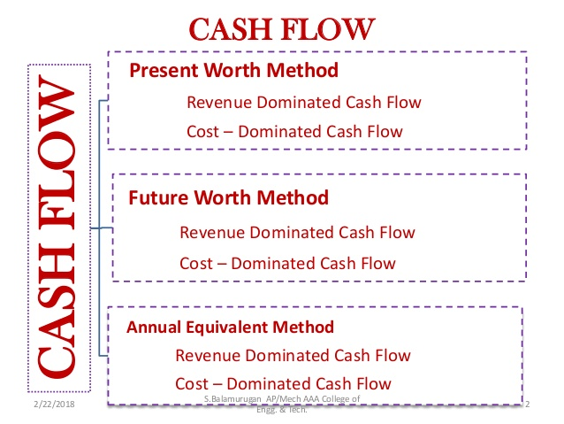

Slide 3
Cost Dominated Cash Flow
OUTFLOWS (+VE)
Investment
Expenditure
INFLOWS
(-VE)
Profit
Revenue
Salvage Value

Slide 4
Revenue Dominated Cash Flow
OUTFLOWS
(-VE)
Investment
Expenditure
INFLOWS
(+VE)
Profit
Revenue
Salvage Value

Slide 5
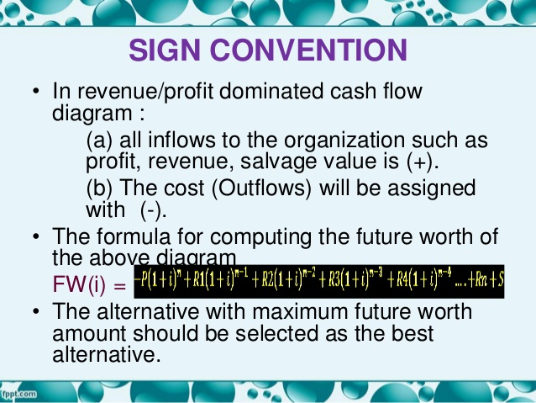

Slide 6
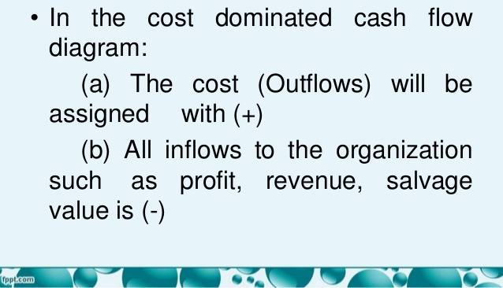

Slide 7
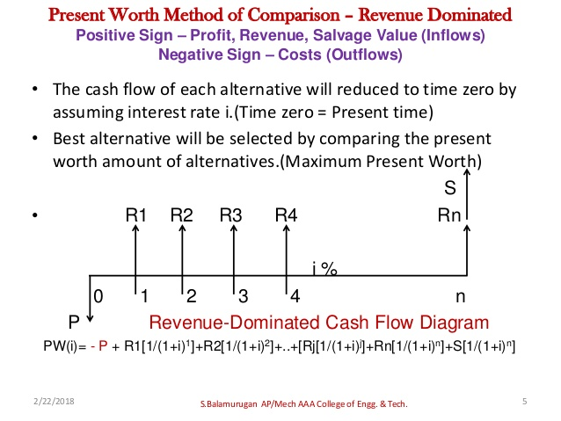

Slide 8
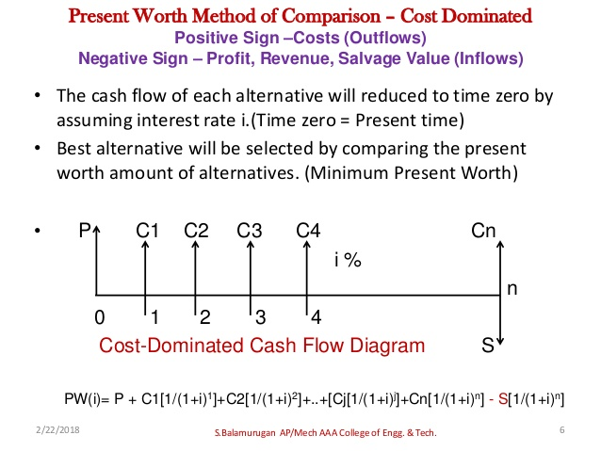

Slide 9
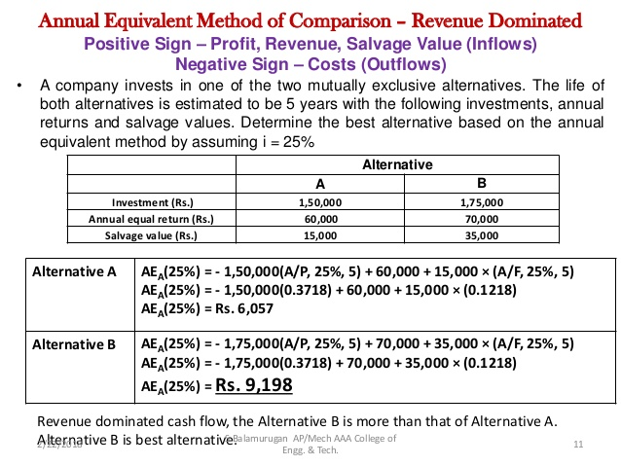

Slide 10
Production engineers of a manufacturing firm have proposed a new equipment to increase productivity of manual gas cutting operation. The initial investment is Rs 5,00,000 and equipment will have a salvage value of Rs 1,00,000 at the end of its expected life of 5 years. Increased productivity will yield an annual revenue of Rs 2,00,000 per year. If the firm’s minimum attractive rate of return is 15%; is the procurement of new equipment economically justified? Use Present worth, Annual Equivalent and Future Worth Method.

Slide 11
GIVEN:- P= -5,00,000 F= 1,00,000 N=5 YEARS i= 0.15 A= 2,00,000 REVENUE BASED

Slide 12
PW= -P + F P + A P

Slide 13
PW= -5,00,000 + 1,00,000 (P/F, 0.15,5) + 2,00,000 (P/A, 0.15,5) = 2,20,160 > 0 It is economically justified.

Slide 14
FW= -P F + F + A F

Slide 15
FW = -5,00,000 (F/P, 0.15,5) + 1,00,000 + 2,00,000 (F/A, 0.15,5) = 4,42,500 > 0 It is economically justified.

Slide 16
AW= -P A + F A + A

Slide 17
AW = -5,00,000 (A/P, 0.15,5) + 2,00,000 + 1,00,000 (A/F, 0.15,5) = 65,653.79525 > 0 It is economically justified.

Slide 18
Investment proposals A and B have the net cash flows as given in the table. Compare the Present worth of A with that of B at i=18%. Which proposal should be selected?
PROPOSAL | 0 | 1 | 2 | 3 | 4
A | -10,000 | 3000 | 3000 | 7000 | 6000
B | -10,000 | 6000 | 6000 | 3000 | 3000

Slide 19
For A: P=-10,000 R=0.18 F1=3000 F2=3000 F3=7000 F4=6000 FOR B: P=-10,000 R=0.18 F1=6000 F2=6000 F3=3000 F4=3000 REVENUE BASED

Slide 20
PW(A)= -10,000 + 3000(P/F, 0.18, 1) + 3000(P/F, 0.18, 2) + 7000(P/F, 0.18, 3) + 6000(P/F, 0.18, 4) = Rs 2052.10

Slide 21
PW(B)= -10,000 + 6000(P/F, 0.18, 1) + 6000(P/F, 0.18, 2) + 3000(P/F, 0.18, 3) + 3000(P/F, 0.18, 4) = Rs 2767.40 . B will be selected.

Slide 22
A granite company is planning to buy a fully automated granite cutting machine. If it is purchased under installment basis, the company has to pay 25% of the cost (cost = Rs 16,00,000) at the time of purchase and the remaining amount in 10 annual equal installments of Rs 2,00,000 each. Suggest the best alternative for the company using present worth basis at i=18%

Slide 23
P= 4,00,000 A=2,00,000 R=0.18 N=10 COST BASED

Slide 24
PW= 2,00,000 (P/A, 0.18,10) + 4,00,000 = Rs 12,98,820 second option is selected.

Slide 25
A finance company advertises two investment plans. In plan I, company pays Rs 12,000 after 15 years for every 1000 invested now. In plan II, for every Rs 1000 invested now, the company pays Rs 4000 at the end of 10th year and Rs 4000 at the end of 15th year. Select the best alternative plan from investor’s point of view by using present worth amount. (i= 12%)

Slide 26
Plan l: P= -1000 F=12,000 R=0.12 N=15 Plan II: P= -1000 F1= 4000, N=10 F2= 4000, N=15 R=0.12 N=15

Slide 27
PW: -1000 + 12,000(P/F, 0.12,15) = Rs 1192.40 PW: -1000 + 4000(P/F, 0.12,10) + 4,000(P/F, 0.12,15) = Rs 1018.8 Plan 1 is selected.

Slide 28
A man owns a corner flat. He must decide which of the several alternatives to select in trying to obtain a desirable return on his investment. After much study and calculations, he decides that the two best alternatives are as given below. Which one will be selected based on Future worth analysis? (i= 12%)
 | Build gas station | Build soft ice-cream stand
First cost | 20,00,000 | 36,00,000
Annual Property Tax | 80,000 | 1,50,000
Annual Income | 8,00,000 | 9,80,000
Life | 20 | 20

Slide 29
A(Build gas station)= 8,00,000-80,000= 7,20,000 A(Build soft ice-cream stand)= 9,80,000- 1,50,000 = 8,30,000 Revenue based
 | Build gas station | Build soft ice-cream stand
P | 20,00,000 | 36,00,000
A | 80,000 | 1,50,000
A | 8,00,000 | 9,80,000
N | 20 | 20

Slide 30
FW(Build gas station)= -20,00,000(F/P, 20,0.12) + 7,20,000 (F/A, 20,0.12) = Rs 3,25,85,440

Slide 31
FW(Build soft ice-cream stand)= -36,00,000(F/P, 20,0.12) + 8,30,000 (F/A, 20,0.12) = Rs 2,50,77,560

Slide 32
M/S Krishna Casting Ltd. Is planning to replace its annealing furnace. It has received tenders from three different original manufacturers of annealing furnace. The details are as follows: (i= 20%). Which one will be selected based on Future worth analysis?
Manufacturers | 1 | 2 | 3
Initial Cost | 80,00,000 | 70,00,000 | 90,00,000
Life | 12 | 12 | 12
Annual Maintenance Cost | 8,00,000 | 9,00,000 | 8,50,000
Salvage Value | 5,00,000 | 4,00,000 | 7,00,000

Slide 33
Cost based
Manufacturers | 1 | 2 | 3
P | 80,00,000 | 70,00,000 | 90,00,000
N | 12 | 12 | 12
A | 8,00,000 | 9,00,000 | 8,50,000
F | 5,00,000 | 4,00,000 | 7,00,000

Slide 34
FW(Alternative 1)= 80,00,000 (F/P, 12,0.20) + 8,00,000 (F/A, 12,0.20) - 5,00,000 = Rs 10,24,92,800

Slide 35
FW(Alternative 2)= 70,00,000 (F/P, 12,0.20) + 9,00,000 (F/A, 12,0.20) - 4,00,000 = Rs 9,76,34,900

Slide 36
FW(Alternative 3)= 90,00,000 (F/P, 12,0.20) + 8,50,000 (F/A, 12,0.20) - 7,00,000 = Rs 11,31,87,850

Slide 37
A Company is planning to purchase an advance machine centre. Three original manufacturers have responded to its tenders whose particulars are tabulated as follows. Which one will be selected based on Annual Equivalent Worth analysis?
Manufacturers | Down payments | Yearly equal installments | Number of Installments | Rate of Interest (%)
1 | 5,00,000 | 2,00,000 | 15 | 20
2 | 4,00,000 | 3,00,000 | 15 | 20
3 | 6,00,000 | 1,50,000 | 15 | 20

Slide 38
COST BASED
Manufacturers | P | A | N | I
1 | 5,00,000 | 2,00,000 | 15 | 20
2 | 4,00,000 | 3,00,000 | 15 | 20
3 | 6,00,000 | 1,50,000 | 15 | 20

Slide 39
AE(Alternative 1)= 5,00,000 (A/P, 15,0.20) + 2,00,000 = Rs 3,06,950

Slide 40
AE(Alternative 2)= 4,00,000 (A/P, 15,0.20) + 3,00,000 = Rs 3,85,560

Slide 41
AE(Alternative 3)= 6,00,000 (A/P, 15,0.20) + 1,50,000 = Rs 2,78,340

